Slide 1





Java MVC Frameworks
The Right Way: Architecture
Java MVC Frameworks
SoftUni Team
Technical Trainers
Software University
http://softuni.bg

Slide 2
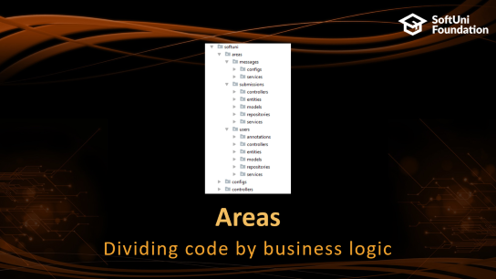
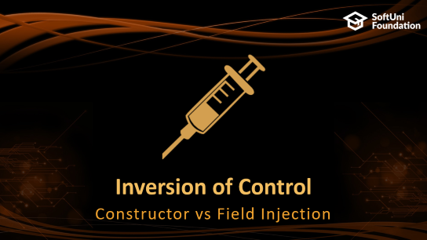
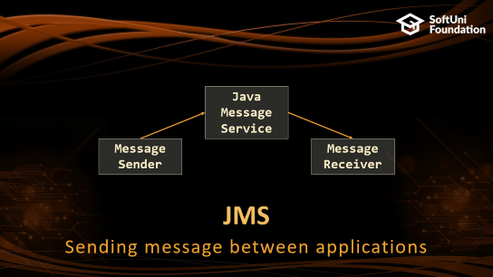
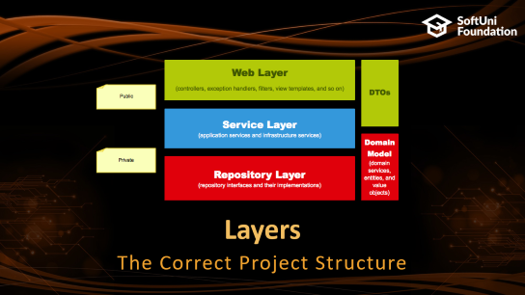

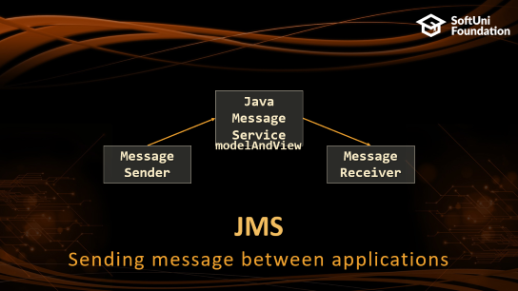
Table of Contents

Slide 3
Questions
sli.do #java-web

Slide 4

Inversion of Control
Constructor vs Field Injection

Slide 5

Field Injection
Easy to write
Easy to add new dependencies
It hides potential architectural problems!
@Autowired
private ServiceA serviceA
@Autowired
private ServiceB serviceB
@Autowired
private ServiceC serviceC
Notes:
http://www.thymeleaf.org/doc/tutorials/3.0/usingthymeleaf.html

Slide 6

Constructor Injection
Time Consuming
Harder to add dependencies
It shows potential architectural problems!
@Autowired
public ControllerA(ServiceA serviceA, ServiceB serviceB, ServiceC serviceC) {
this.serviceA = serviceA;
this.serviceB = serviceB;
this.serviceC = serviceC;
}
Notes:
http://www.thymeleaf.org/doc/tutorials/3.0/usingthymeleaf.html

Slide 7
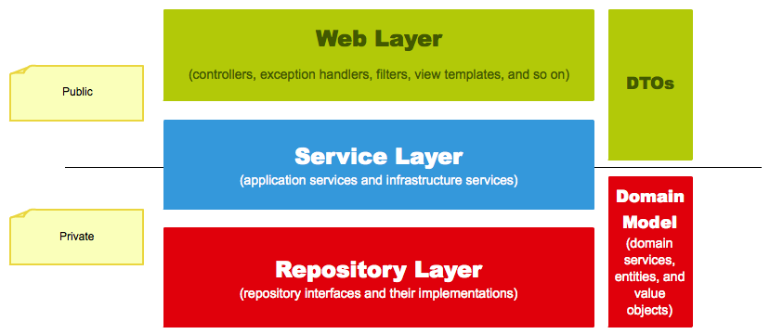
Layers
The Correct Project Structure

Slide 8
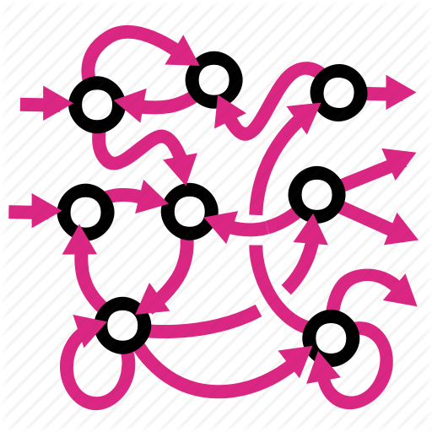

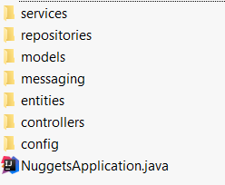

Layers
We are used to splitting our code based on its functionality:
It gets hard to navigate in bigger applications

Slide 9
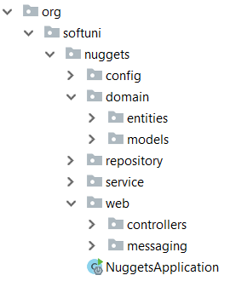


Layers (2)
Splitting the project into different modules
Each module corresponding to the application layer
Makes it easier to navigate

Slide 10

Thin Controllers
Creating Simple Components

Slide 11
Thin Controllers
Controllers should follow well known principles such as DRY and KISS
Should delegate functionality to the model layer
The model layer consists of application logic, e.g. services, executors, strategies, mappers, DTOs, entities, etc.

Slide 12
Thin Controller Example
@PreAuthorize("isAuthenticated()")
@GetMapping("{id}")
public ModelAndView details(ModelAndView modelAndView, @PathVariable Long id) {
GameDetailsView game = gameService.get(id);
modelAndView.setViewName("index");
modelAndView.addObject("game", game);
modelAndView.addObject("title", game.getTitle());
return modelAndView;
}

Slide 13
JMS
Java Message Service
Message Sender
Message Receiver
Sending message between applications

Slide 14
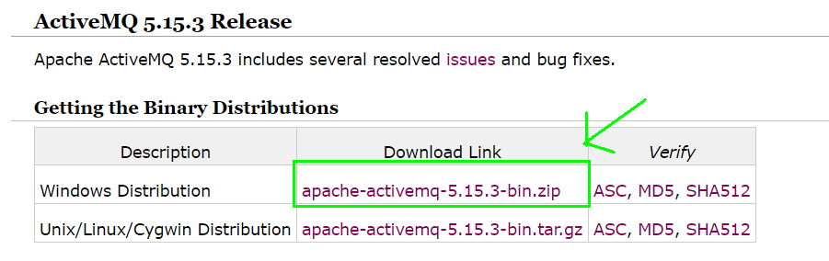
JMS - What we need?
Apache ActiveMQ.
Download here.

Slide 15
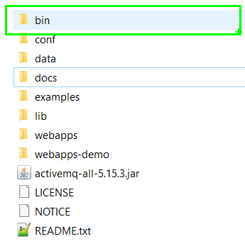
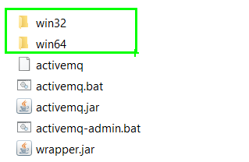

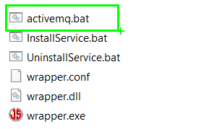
JMS - What we need?
Unzip the archive.
Go to bin/ folder.
Depending on your OS, chose one of the 2 folders.
Run activemq.bat.

Slide 16
JMS - What we need?
Apache ActiveMQ.
Maven Dependencies:
<dependency>
<groupId>org.springframework.boot</groupId>
<artifactId>spring-boot-starter-activemq</artifactId>
</dependency>

Slide 17
JMS - Connection Factory
Creating connection to the ActiveMQ service
String DEFAULT_BROKER_URL = "tcp://localhost:61616"; @Bean
public ActiveMQConnectionFactory connectionFactory() {
ActiveMQConnectionFactory connectionFactory = new ActiveMQConnectionFactory();
connectionFactory.setBrokerURL(DEFAULT_BROKER_URL);
return connectionFactory;
}

Slide 18
JMS - Sending Messages
You will need to create JmsTemplate Bean that will use the connection factory from the previous slide
@Bean
public JmsTemplate jmsTemplate(){
JmsTemplate template = new JmsTemplate();
template.setConnectionFactory(connectionFactory());
return template;
}

Slide 19
JMS - Sending Messages (2)
To send a message you only need to inject the bean and use the convertAndSend() method:
@Autowired
private JmsTemplate jmsTemplate;
public void sendMessage(final String message) {
jmsTemplate.convertAndSend(message);
}

Slide 20
JMS - Receiving Messages
To receive a message in the other application just use the @JmsListener annotation:
@JmsListener(destination = "message-queue")
public void readMessage(Message<String> message) throws JMSException {
System.out.println(message.getPayload());
}

Slide 21
Live Demo
Java Message Service
Message Sender
Message Receiver

Slide 22


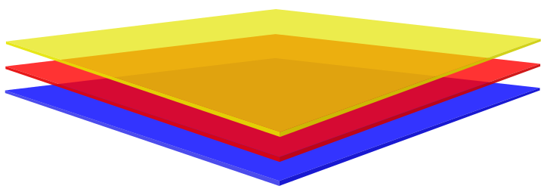
Summary
Constructor injection – the best way for DI
Splitting your application code by layers
Each layer has its own module
Every component should be as "thin" as possible
JMS lets multiple applications communicate

Slide 23







Java MVC Frameworks – Architecture
https://softuni.bg/courses/java-mvc-frameworks-spring

Slide 24






SoftUni Diamond Partners

Slide 25


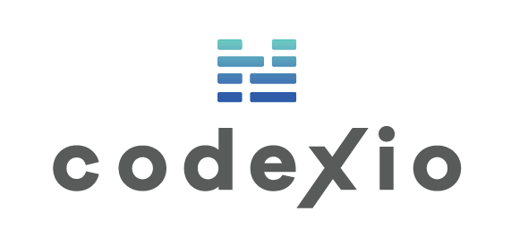



SoftUni Diamond Partners

Slide 26
License
This course (slides, examples, demos, videos, homework, etc.) is licensed under the "Creative Commons Attribution-NonCommercial-ShareAlike 4.0 International" license

Slide 27





Trainings @ Software University (SoftUni)
Software University – High-Quality Education, Profession and Job for Software Developers
softuni.bg
Software University Foundation
http://softuni.foundation/
Software University @ Facebook
facebook.com/SoftwareUniversity
Software University Forums
forum.softuni.bg

